Slide 1
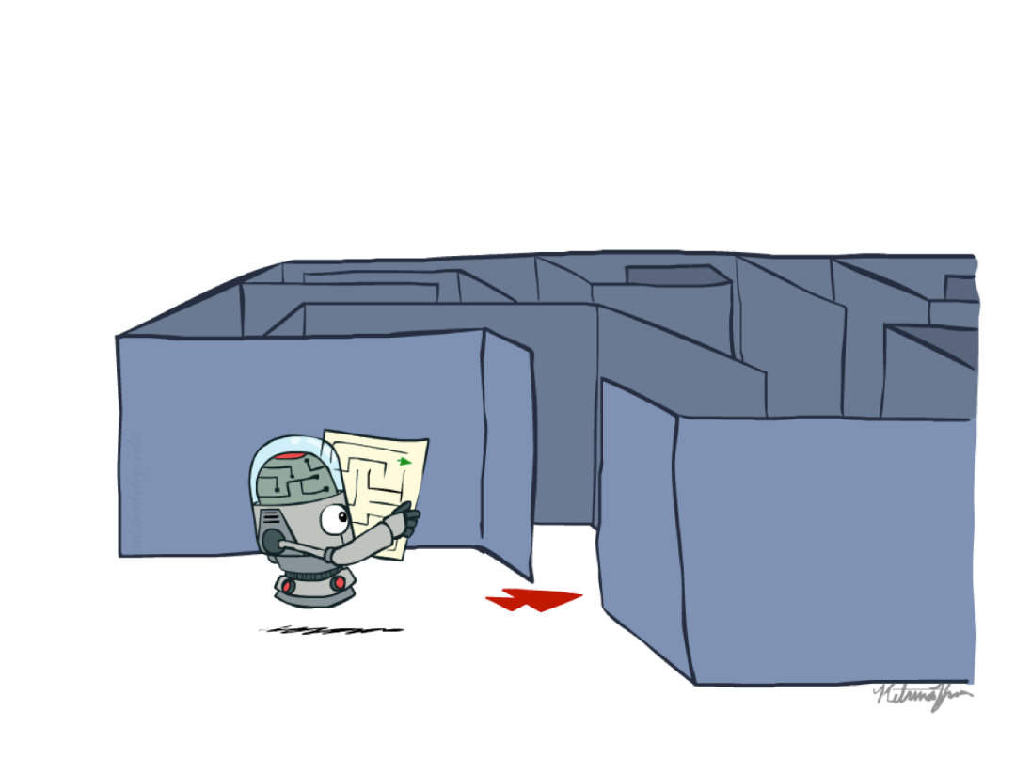
Problem Solving Using Search
Introduction to State Space Search
Slide credits: AI BERKELEY

Slide 2
Previous Lecture
Intelligent Agent
Performance measure
Different types of Environments
IA examples based on Environment
Agent types
  Simple reflex agents
  Reflex agents with state/model
  Goal-based agents
  Utility-based agents

Slide 3
Introduction
Suppose an agent can execute several actions immediately in a given state
It doesn’t know the utility of these actions
Then, for each action, it can execute a sequence of actions until it reaches the goal
The immediate action which has the best sequence (according to the performance measure) is then the solution
Finding this sequence of actions is called search, and the agent which does this is called the problem-solver.
Its possible that some sequence might fail, e.g., getting stuck in an infinite loop, or unable to find the goal at all.

Slide 4
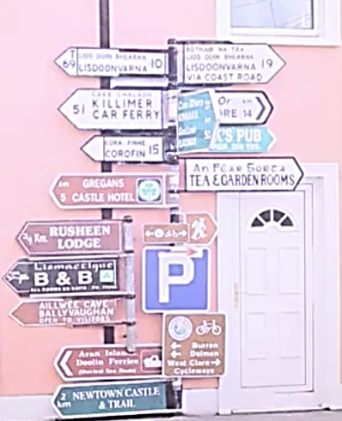
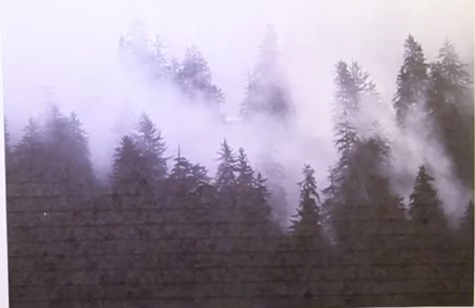

Slide 5
Problem-Solving Agent
Problem solving agent is a goal-based agent that decides what to do by systematically finding sequences of actions that lead to desirable states (goal)
Many problems can be represented as a set of states and a set of rules of how one state is transformed to another.

Slide 6
Examples
Getting from home to UCP
  START: home location
  GOAL: UCP FIT Department.
  OPERATORS: move one block, turn
Loading a moving truck
  START: apartment full of boxes and furniture
  GOAL: empty apartment, all boxes and furniture in the truck
  OPERATORS: select item, carry item from apartment to truck, load item
Getting settled
  START: items randomly distributed over the place
  GOAL: satisfactory arrangement of items
  OPERATORS: select item, move item

Slide 7
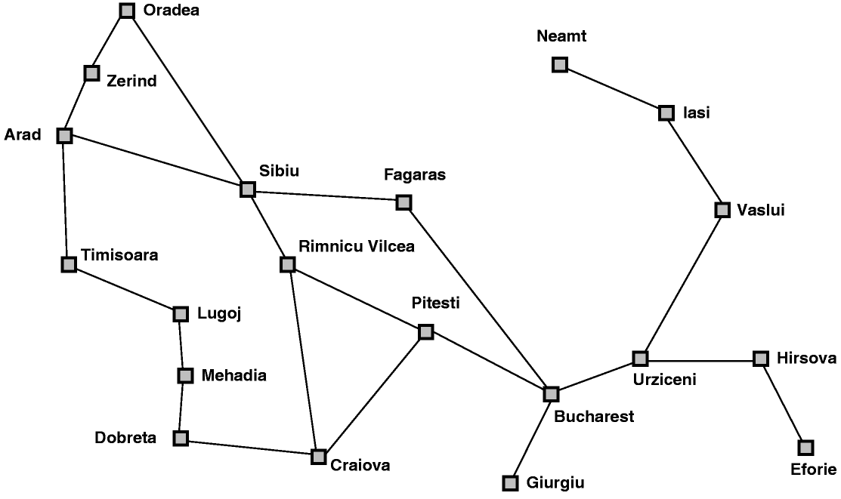
Classical AI Search Problem
Touring Agent Problem (Map Search / Navigation)

Slide 8


Slide 9


Slide 10
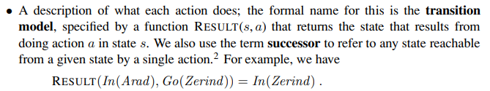

Slide 11


Slide 12
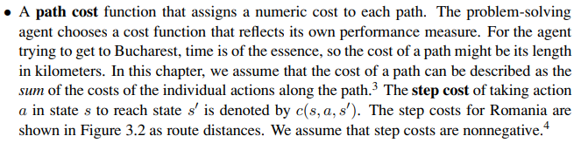

Slide 13
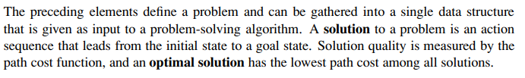

Slide 14
Classical AI Search Problem
8-Puzzle
2
1
3
1
2
3
4
7
6
4
5
6
5
8
7
8

Slide 15
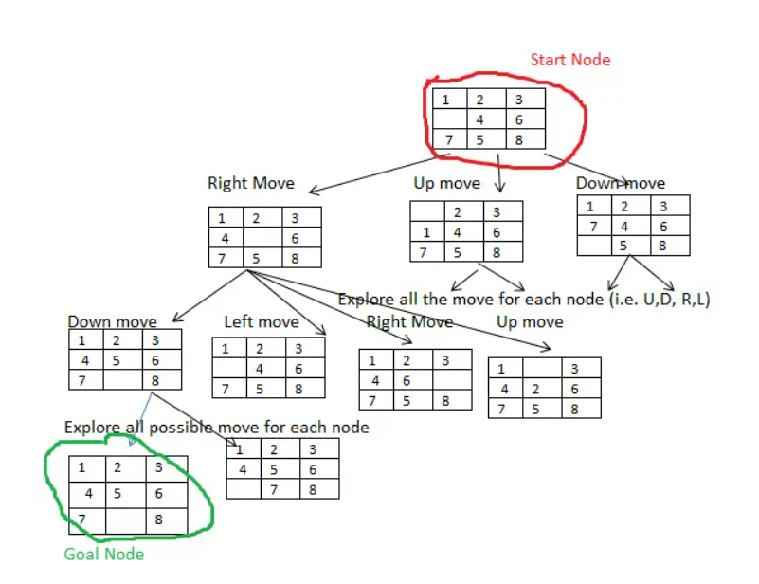

Slide 16
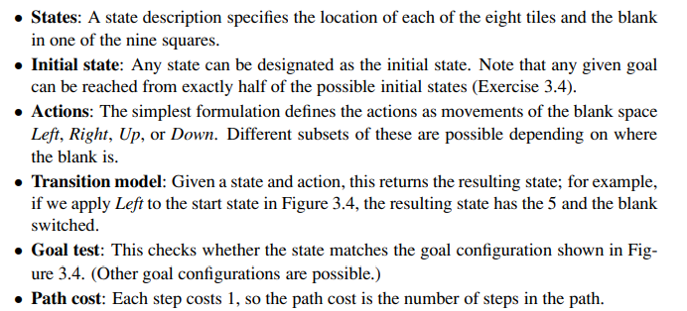

Slide 17
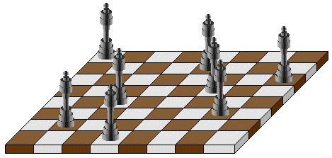
Classic AI Search Problems
5-Queens:
1
2
3
4
5
1
2
3
4
5

Slide 18
Classic AI Search Problems
5-Queens:
1
2
3
4
5
1
2
3
4
5

Slide 19
Classic AI Search Problems
5-Queens:
1
2
3
4
5
1
2
3
4
5

Slide 20
Classic AI Search Problems
5-Queens:
1
2
3
4
5
1
2
3
4
5

Slide 21
Classic AI Search Problems
5-Queens:
1
2
3
4
5
1
2
3
4
5

Slide 22
Classic AI Search Problems
5-Queens:
1
2
3
4
5
1
2
Solution !!
No Queen is under Attack
3
4
5

Slide 23

River Crossing Problem
A farmer wishes to carry a wolf, a duck and corn across a river, from the south to the north shore.
  The farmer has a small rowing boat.
  The boat can only carry at most the farmer and one other item.
  If left unattended the wolf will eat the duck and the duck will eat the corn.
How can the farmer safely transport the wolf, the duck and the corn to the opposite shore?

Slide 24
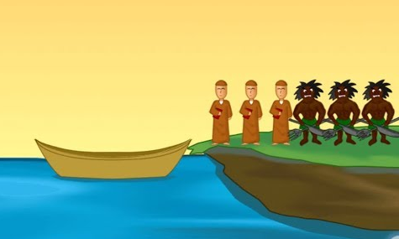


Missionaries and cannibals
Three missionaries and three cannibals are on the left bank of a river.
There is one boat which can hold one or two people.
Find a way to get everyone to the right bank, without ever leaving a group of missionaries in one place outnumbered by cannibals in that place.
Initial State
Goal State

Slide 25

Problem Solving by Searching
Problem Formulation

Slide 26
Search in AI
Search in Data Structures
  You’re given an existent tree.
  You search it in different orders.
  It resides in memory.
Search in Artificial Intelligence
  The tree does not exist.
  You have to generate it as you go.
  For realistic problems, it does not fit in memory.

Slide 27
Problem Formulation(defining problem in proper way)
A Problem Space consists of
The current state of the world (initial state)
A description of the actions we can take to transform one state of the world into another (operators or successor function).
A description of the desired state of the world (goal state), this could be implicit or explicit.
A solution consists of the goal state, or a path to the goal state.

Slide 28
Problem Formulation
Initial state
Actions (operators, successor functions)
State space
Path
Goal test
Solution
Path cost
Total cost

Slide 29
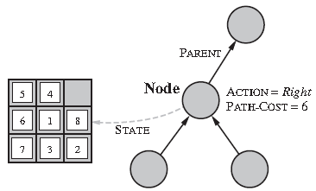
Representation of a Search/State Space
A convenient way of representing search spaces is as a graph
  States are nodes
  Actions are edges
  Initial state is root
  Solution is path from root to goal node
  Edges sometimes have associated costs
  States resulting from operator are children

Slide 30

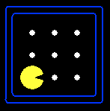





State Space Representation
A search problem consists of:
  A state space
  A successor function
  (with actions, costs)
  A start state and a goal test
A solution is a sequence of actions (a plan) which transforms the start state to a goal state
“N”, 1.0
“E”, 1.0
Notes:
Often comes back on exams
Goal test – sometimes more than one state that satisfies having achieved the goal, for example, “eat all the dots”
Abstraction

Slide 31
State Space Graphs
State space graph: A mathematical representation of a search problem
  Nodes are (abstracted) world configurations
  Arcs represent successors (action results)
  The goal test is a set of goal nodes (maybe only one)
In a state space graph, each state occurs only once!
We can rarely build this full graph in memory (it’s too big), but it’s a useful idea
a
G
b
c
d
e
f
S
h
p
q
r
Tiny search graph for a tiny search problem

Slide 32
Search Trees
This is now / start
“N”, 1.0
“E”, 1.0
Possible futures
A search tree:
  A “what if” tree of plans and their outcomes
  The start state is the root node
  Children correspond to successors
  Nodes show states, but correspond to PLANS that achieve those states
  For most problems, we can never actually build the whole tree
Notes:
Different plans that achieve the same state, will be different nodes in the tree.

Slide 33
State Space Graphs vs. Search Trees
State Space Graph
Each NODE in the search tree is an entire PATH in the state space graph.
Search Tree
S
a
G
d
e
p
b
c
q
b
c
e
h
r
d
e
f
a
a
h
r
p
q
f
S
h
We construct both on demand – and we construct as little as possible.
p
q
f
q
c
G
p
q
r
q
c
G
a
a

Slide 34
Approach
Start with a frontier that contains the initial state.
Repeat:
  If the frontier is empty, then no solution.
  Remove a node from the frontier.
  If node contains goal state, return the solution.
  Expand node, add resulting nodes to the frontier.

Slide 35

Quiz: State Space Graphs vs. Search Trees
Consider this 4-state graph:
How big is its search tree (from S)?
a
S
G
b
Important: Lots of repeated structure in the search tree!

Slide 36
Quiz: State Space Graphs vs. Search Trees
Consider this 4-state graph:
How big is its search tree (from S)?
a
s
a
b
S
G
b
G
a
G
b
a
G
b
G
…
…
Important: Lots of repeated structure in the search tree!

Slide 37
Revised Approach
Start with a frontier that contains the initial state.
Start with an empty explored set.
Repeat:
  If the frontier is empty, then no solution.
  Remove a node from the frontier.
  If node contains goal state, return the solution.
  Add the node to the explored set.
  Expand node, add resulting nodes to the frontier if they aren't already in the frontier or the explored set.

Slide 38
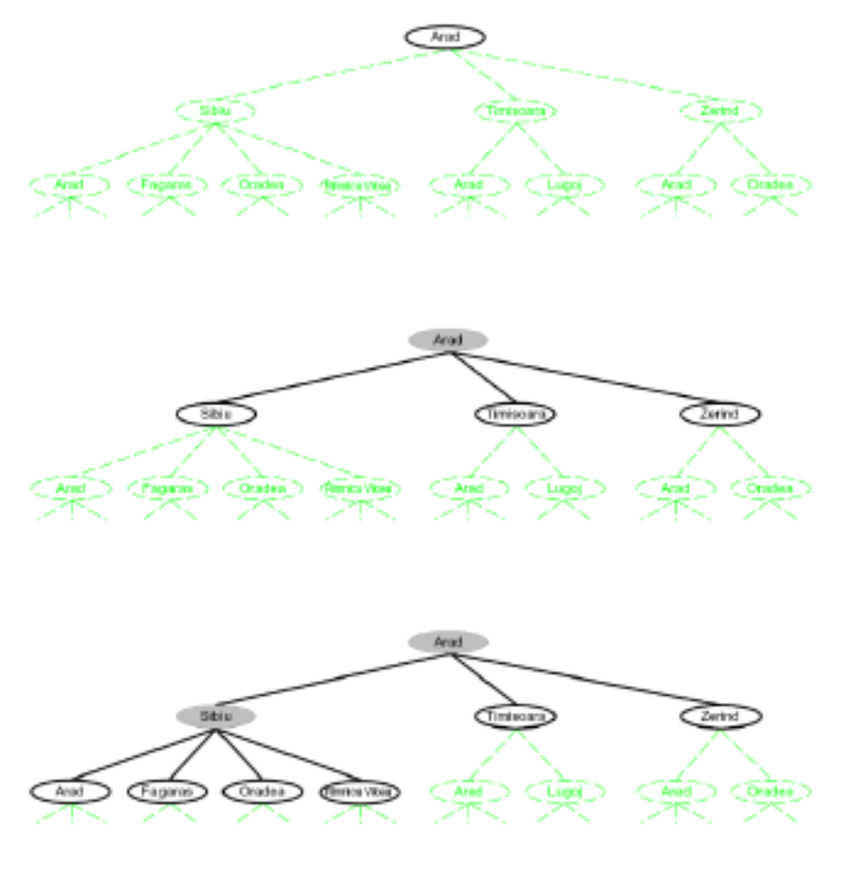
Searching with a Search Tree
Search:
(1) Expand out potential plans (tree nodes)
(2) Maintain fringe (peripheral) partial plans under consideration.
(3) Try to expand as few tree nodes as possible

Slide 39
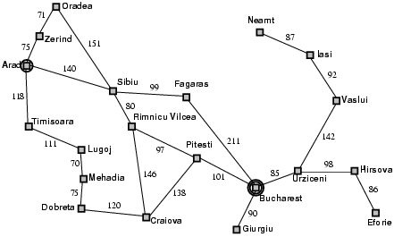
Example: Romania

Slide 40
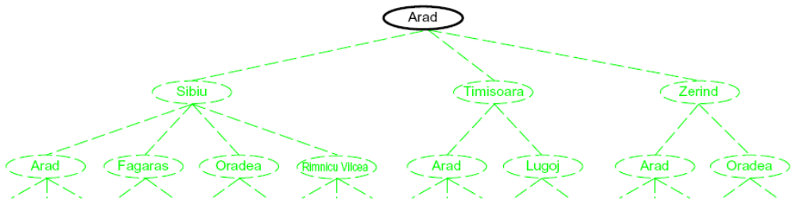
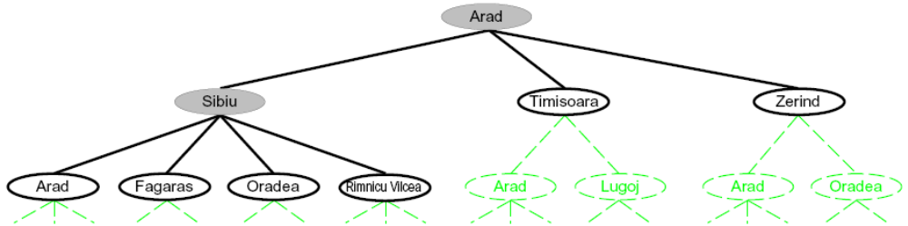
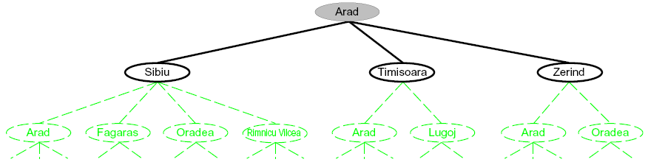
Searching with a Search Tree
Search:
  Expand out potential plans (tree nodes)
  Maintain a fringe of partial plans under consideration
  Try to expand as few tree nodes as possible

Slide 41
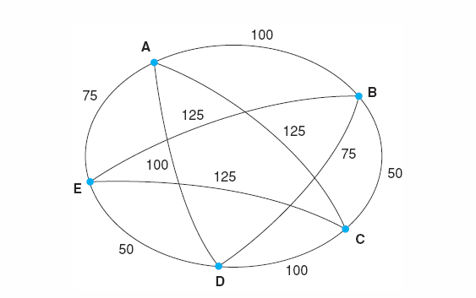
Problem Formulation: TSP
Travelling Salesperson Problem (TSP)
  Suppose a salesman has five cities to visit and then must return home.
  The goal of the problem is to find the shortest path for salesman to travel, visiting each city, and then returning to the starting city.

Slide 42
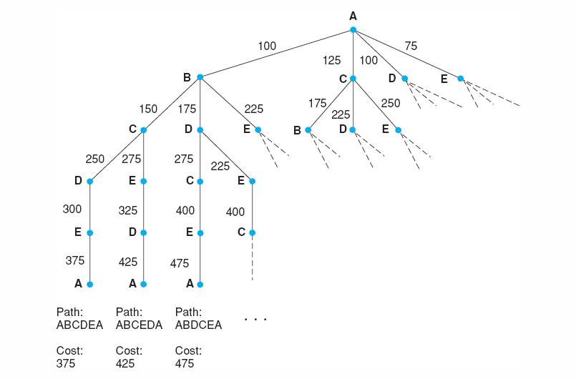
Search for the travelling salesperson problem. Each arc is marked with the total weight of all paths from the start node (A) to its endpoint.
Luger: Artificial Intelligence, 6th edition. © Pearson Education Limited, 2009

Slide 43
Problem Formulation: 8-Puzzle Problem
Initial State
Operators
Goal State
2
1
3
Slide blank square left.
Slide blank square right.
….
1
2
3
4
7
6
4
5
6
5
8
7
8

Slide 44
Problem Formulation: 8-Puzzle Problem
Representing states:
For the 8-puzzle
3 by 3 array
  5, 6, 7
  8, 4, BLANK
  3, 1, 2
A vector of length nine
  5, 6, 7, 8, 4, BLANK, 3, 1, 2
A list of facts
  Upper_left = 5
  Upper_middle = 6
  Upper_right = 7
  Middle_left = 8
5
6
7
8
4
3
1
2

Slide 45
Problem Formulation: 8-Puzzle Problem
Specifying operators
  There are often many ways to specify the operators, some will be much easier to implement...
Move 1 left
Move 1 right
Move 1 up
Move 1 down
Move 2 left
Move 2 right
Move 2 up
Move 2 down
Move 3 left
Move 3 right
Move 3 up
Move 3 down
Move 4 left
…
5
6
7
Move Blank left
Move Blank right
Move Blank up
Move Blank down
8
4
3
1
2

Slide 46
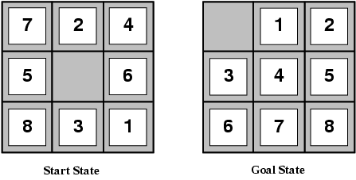
Problem Formulation: 8-Puzzle Problem
states locations of tiles
actions move blank left, right, up, down
goal test goal state (given)
path cost 1 per move

Slide 47
Problem Formulation: 8-Puzzle Problem
1
2
3
1
2
3
Operators: slide blank up, slide blank down, slide blank left, slide blank right
Solution: swap-down, swap-left, swap-up, swap-right, swap-down
Path cost: 5 steps to reach the goal
4
8
4
5
6
7
6
5
7
8
Initial state
Goal state
1
2
3
1
2
3
1
2
3
1
2
3
1
2
3
1
2
3
4
8
4
8
5
4
8
5
4
5
4
5
4
5
6
7
6
5
7
6
7
6
7
8
6
7
8
6
7
8

Slide 48
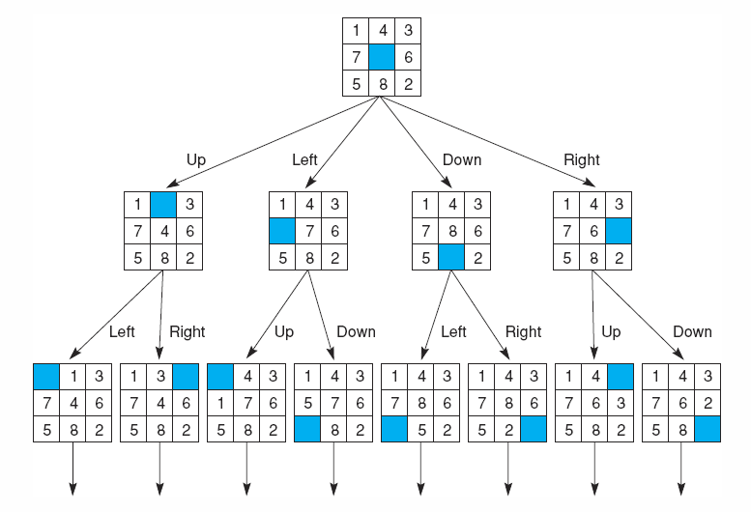
State space of the 8-puzzle generated by “move blank” operations
Notes:
Insert fig 3.8

Slide 49
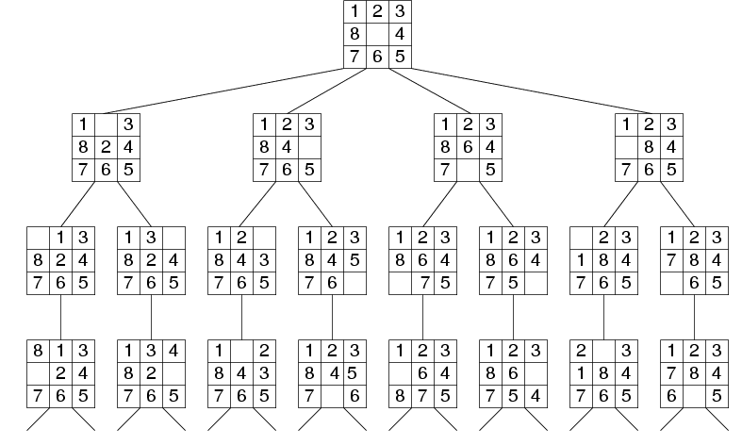
Fragment of 8-Puzzle Problem Space

Slide 50

Problem Formulation:
Missionaries and Cannibals
Three missionaries and three cannibals are on the left bank of a river.
There is one boat which can hold one or two people.
Find a way to get everyone to the right bank, without ever leaving a group of missionaries in one place outnumbered by cannibals in that place.

Slide 51
Missionaries and cannibals
States: three numbers (i, j, k) representing the number of missionaries, cannibals, and boats on the left bank of the river.
Initial state: (3, 3, 1)
Operators: take one missionary, one cannibal, two missionaries, two cannibals, one missionary and one cannibal across the river in a given direction
Goal Test: reached state (0, 0, 0)?
Path Cost: Number of crossings.

Slide 52
Formalization of the M&C Problem
State space: triple (x,y,z), where x,y, and z represent the number of missionaries, cannibals and boats currently on the original bank.
Initial State: (3,3,1)
Successor function: From each state, either bring one missionary, one cannibal, two missionaries, two cannibals, or one of each type to the other bank.
Note: Not all states are attainable (e.g., (0,0,1)), and some are illegal.
Goal State: (0,0,0)
Path Costs: 1 unit per crossing

Slide 53


Missionaries and Cannibals
Solution = the sequence of actions within the path :
[(3,3,1)→ (2,2,0)→(3,2,1) →(3,0,0) →(3,1,1) →(1,1,0) →(2,2,1) →(0,2,0) →(0,3,1) →(0,1,0) → (0,2,1) →(0,0,0)]
Cost = 11 crossings

Slide 54
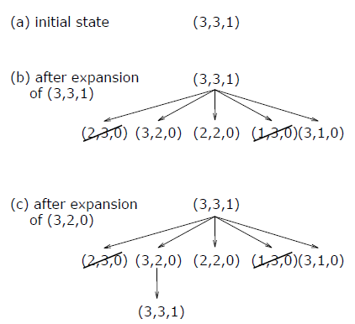
Missionaries and Cannibals
From the initial state, produce all successive states step by step 􀃆search tree.

Slide 55
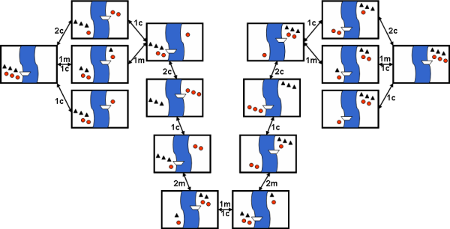
Missionaries and Cannibals
Search-space for the Missionaries and Cannibals problem

Slide 56
The River Problem
A farmer wishes to carry a wolf, a duck and corn across a river, from the south to the north shore. The farmer has a small rowing boat. The boat can only carry at most the farmer and one other item.
If left unattended the wolf will eat the duck and the duck will eat the corn.
How can the farmer safely transport the wolf, the duck and the corn to the opposite shore?
Farmer, Wolf,
Duck and Corn
River
River
boat
boat
Farmer, Wolf,
Duck and Corn

Slide 57
The River Problem
The River Problem:
F=Farmer W=Wolf D=Duck C=Corn /=River
How can the farmer safely transport the wolf, the duck and the corn to the opposite shore?
-/FWCD
FWCD/-

Slide 58
The River Problem
Problem formulation:
  State representation: location of farmer and items in both sides of river
  [items in South shore / items in North shore] : (FWDC/-, FD/WC, C/FWD …)
  Initial State: farmer, wolf, duck and corn in the south shore FWDC/-
  Goal State: farmer, duck and corn in the north shore -/FWDC
  Operators: the farmer takes in the boat at most one item from one side to the other side
  (F-Takes-W, F-Takes-D, F-Takes-C, F-Takes-Self [himself only])
  Path cost: the number of crossings

Slide 59
The River Problem
Problem solution: (path Cost = 7)
  While there are other possibilities here is one 7 step solution to the river problem
F
D
D
F
W
D
F-Takes-D
F-Takes-F
F-Takes-W
F
W
D
C
W
C
F
W
C
C
Initial State
WC/FD
FWC/D
C/FWD
F-Takes-D
F
W
D
C
W
C
F
W
C
W
F-Takes-D
F-Takes-F
F-Takes-C
F
D
D
F
D
C
Goal State
FD/WC
D/FWC
FDC/W

Slide 60
Summary
Search: process of constructing sequences of actions that achieve a goal given a problem.
It is assumed that the environment is observable, deterministic, static and completely known.
Goal formulation is the first step in solving problems by searching. It facilitates problem formulation.
Formulating a problem requires specifying five components:
  State representation,
  Initial state,
  Goal state,
  Operators (actions), and
  Path cost function.

